Slide 1
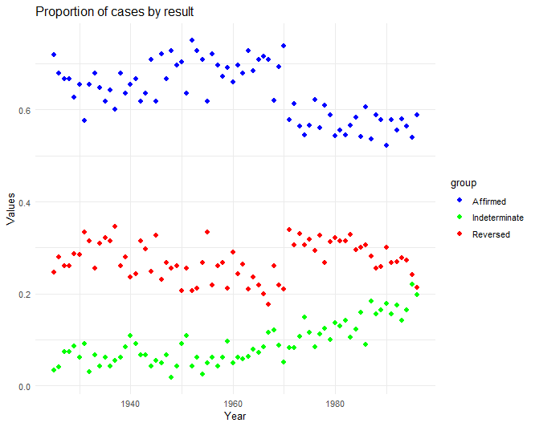
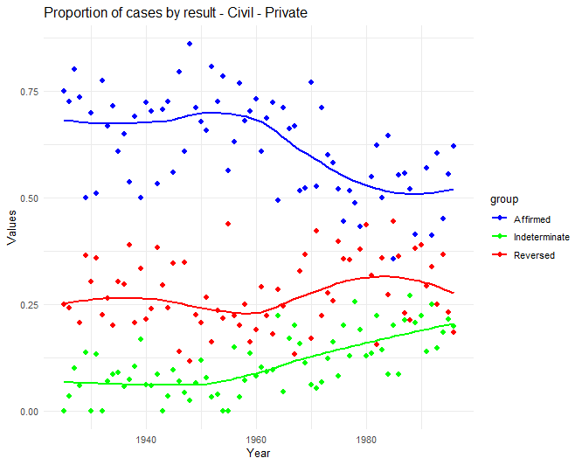
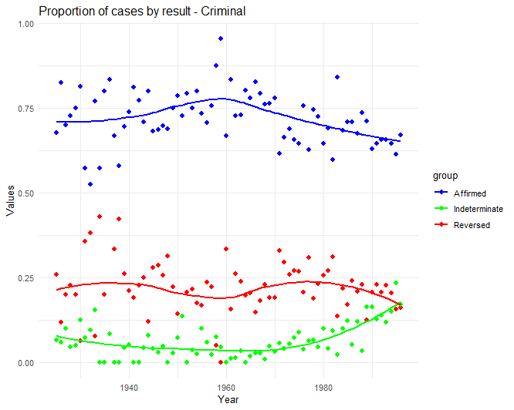
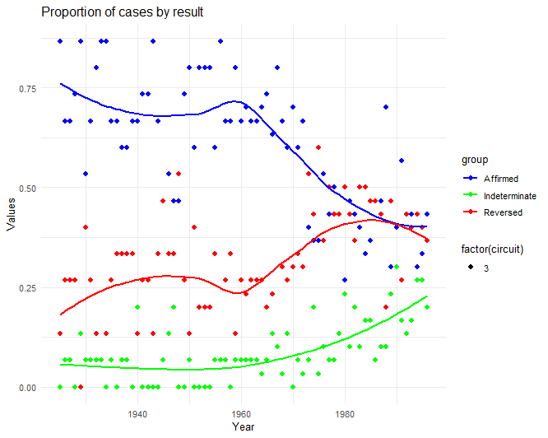
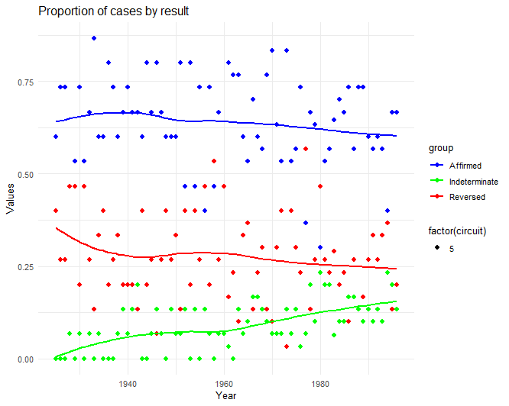
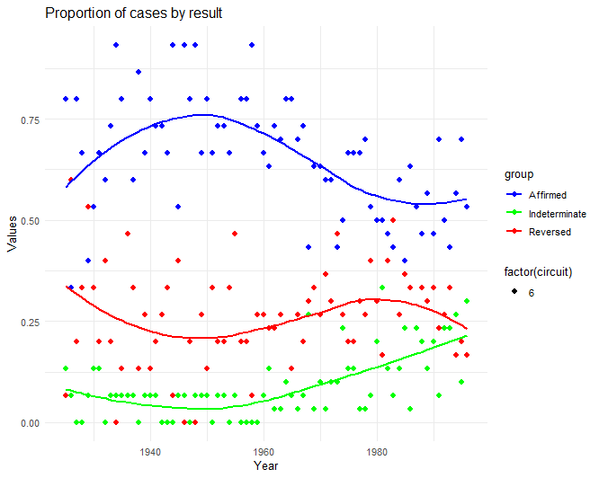
Affirm or Deny? An analysis of a historical discontinuity in appellate decision-making.
Overview:
This paper examines patterns of appellate decision-making in the United States federal circuit courts from the 1920s through the 1990s, focusing on the rates at which circuit courts affirm or reverse district court decisions. While affirmation rates remain relatively stable over most of this period, we identify a sharp and enduring decline beginning around 1970. We explore several potential explanations for this historical discontinuity, including changes in case composition, judicial behavior, and institutional dynamics, and systematically assess their plausibility. Our analysis highlights the specific categories of cases and circuits most responsible for the shift, offering new insights into the forces shaping appellate outcomes in the federal judiciary.
Appellate Decision Rates - Overall
Appellate Decision Rates – Civil Cases
Appellate Decision Rates – Criminal Cases
Appellate Decision Rates – 3rd Circuit
Appellate Decision Rates – 5th Circuit
Appellate Decision Rates – 6th Circuit
Next Steps:
To build on our preliminary findings, several avenues for further research remain. First, we will incorporate data on district courts to better understand the sources and nature of the decisions being appealed, including whether changes in district court behavior contributed to the observed shift. We will also continue identifying the types of cases driving the change by examining case categories and procedural history—specifically, whether the pattern holds for final judgments, motions to dismiss, or other procedural outcomes. These investigations will include assessing how the directionality of district court decisions interacts with appellate outcomes. In addition, we will analyze appellate judge cohorts to explore whether generational or ideological shifts among judges may explain the discontinuity. A broader legal studies literature review will contextualize our findings within institutional or doctrinal changes during the period. Finally, we will use machine learning tools such as lasso or random forests to uncover the most predictive covariates of appellate outcomes in a data-driven way.

